Slide 1



AstroSage Performance Analysis Project
Shivansh Gupta Date – 14/12/2024

Slide 2

Problem Statement
AstroSage has received a 1 crore investment and aims to optimize its call center operations.
The goal is:-
To determine how to allocate this investment to maximize operational efficiency, customer satisfaction, and profitability.
The Analysis will consider historical call data, performance metrics, and market trends to make informed decisions.

Slide 3

Data Information
Data Dictionary :-
_id: Unique identifier for each record.
user: User ID associated with the record.
chatStatus: Status of the chat (e.g., incomplete, failed, completed).
guru: Unique identifier for the guru.
guruName: Name of the guru.
gid: Guru ID.
uid: User ID.
consultation Type: Type of consultation (e.g., Chat, Call).
website: Source of the consultation (e.g., gurucool).
Refund Status: Indicates if the session is refundable or not (e.g., no-refund).
is WhiteList User: Boolean indicating if the user is whitelisted.
chat Seconds: Duration of the chat in seconds.
queue: Boolean indicating if the session was queued.
FreeCall: Boolean indicating if the call was free.
Free Chat: Boolean indicating if the chat was free.
CreatedAT: Original creation date and time.
updatedAt: Original update date and time.
__v: Version key.
statementEntryId: Identifier for the statement entry.
chatStartTime: Start time of the chat.
chatEndTime: End time of the chat.
timeDuration: Undefined, some technical data as per app. (Don’t use it as the duration of chat/call)
callChannel: Channel used for the call.
calIvrType: IVR type used during the call.
callStatus: Status of the call.
CallSid: Unique identifier for the call session.
amount: Amount charged for the session.
astrologerCallStatus: Status of the astrologer during the call.
astrologerOnCallDuration: Duration of the astrologer's call.
astrologersEarnings: Earnings of the astrologer from the session.
netAmount: Net amount after deductions.
region: Region of the user.
userCallStatus: Status of the user's call.
userOnCallDuration: Duration of the user's call.
rating: Rating assigned based on the session's status..

Slide 4

Methodology
1. Data Preprocessing
Removing Unwanted Columns like _v, _id etc.
Also removing columns that contain only single values like isWhiteListUser.
2. Data Cleaning
Removing duplicates using “Remove Duplicates” method in Data Ribbon.
Filling us the blank cells using various functions like ISBLANK(), IF(), SUMIF(), AVEARAGEIF(), COUNT(), IFERROR() etc.
Using “Find and Replace” functionality, done some changes in Guru Names.
3. Feature Engineering
Created columns like “Weekday”, “Hour of Day”, “CreatedAt Time”, “CreatedAt Day” and many more using “Split Column” functionality in Data ribbon and using String operations like LEFT(), RIGHT(), LEN() etc.
4. Data Analysis
Adding various KPIs and Charts with Slicers in the Dashboard to visualize the analysis.

Slide 5

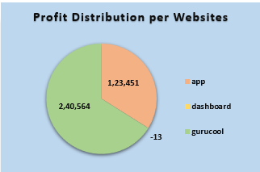
Data Analysis
Profit Distribution Among Websites
Gurucool Platform has made the most profit in both months.
Dashboard made loss but it’s not that large as compared to profits made.

Slide 6
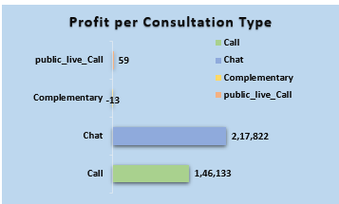
Data Analysis
Profits per Consultation Type
Chats have made the highest profit in both months.
Company achieved loss in Complementary Services but it is not that much significant.
In month of January, only Call and Chat were provided services

Slide 7
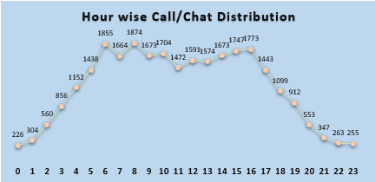
Data Analysis
Hour Wise Call/Chat Distribution
In general, peak hours are from morning 6 to evening 4.
This trend remains similar in month of December but in January, it is irregular
Call peak hours - morning 6 to noon 2.
Chat peak hours - morning 6 to evening 5.

Slide 8
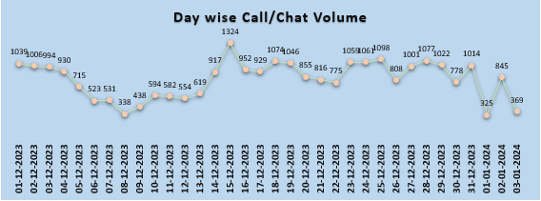
Data Analysis
Day Wise Call/Chat Distribution
In general, Volume is more in December than January.
Call volume is maximum at 10-12-2023 and minimum at 03-01-2024
Chat volume is maximum at 15-12-2023 and minimum at 09-12-2023.
Chat volume curve is much more similar to over curve.

Slide 9
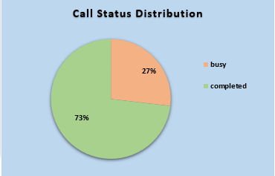
Data Analysis
Call Status Distribution
In both months, most of the Calls are Completed.
The source of Calls are App and Dashboard in which Dashboard has 100% completion of calls.

Slide 10
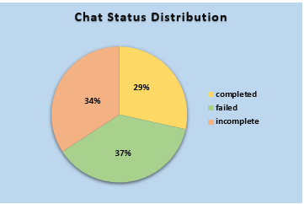
Data Analysis
Chat Status Distribution
In both months, completed Chats are less than other categories.
The failed chats are much more in January than in December.
100% failed chats from app.
Gurucool has almost similar chart compared to overall

Slide 11
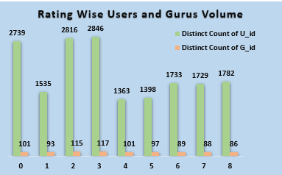
Data Analysis
Rating wise Gurus and Users Volume
Most of the Users have given rating less than 4 to most of the Gurus.
The Average rating is around 2.9.
Also, there is high difference between counts of Users and Gurus, suggesting that many are working overtime.

Slide 12
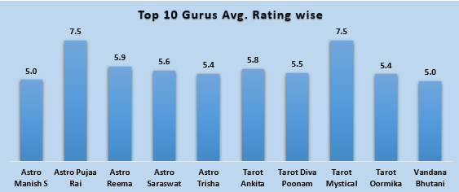
Data Analysis
Top 10 Gurus
Pujaa Rai and Mystical, who has Astro and Tarot Designation respectively has highest Average Satisfaction rating with 7.5/10.
Lowest is 0.0 for Rittika who is Tarot.

Slide 13
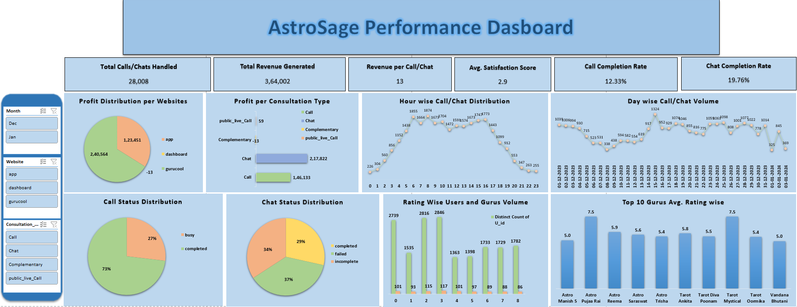
Dashboard

Slide 14
Recommendations
1. Training
Focus training on agents with low ratings to improve performance.
Conduct workshops to enhance communication and technical skills.
Implement mentorship programs with experienced, high-rated agents.
2. Technological Upgrades
Deploy AI-powered chatbots to handle FAQs and initial customer interactions.
Integrate predictive analytics for better demand forecasting and resource allocation.
Utilize speech analytics to monitor call quality, identify inefficiencies, and improve agent performance.
3. Hiring
Hire part-time agents to manage peak period workloads.
Prioritize full-time agents with astrology qualifications to build customer trust and loyalty.

Slide 15

Conclusion
Investing ₹30 Lakhs (30%) in targeted training will address the variation in agent ratings, improving service quality and customer satisfaction.
Allocating ₹50 Lakhs (50%) to technology upgrades will address inefficiencies, support peak call volumes, and enhance customer satisfaction through scalable and data-driven solutions.
Investing ₹20 Lakhs (20%) in hiring will alleviate pressure on agents during peak hours, increasing call-handling capacity while ensuring high-quality service.

Slide 16
Final Thoughts
By addressing key inefficiencies and focusing on customer satisfaction, AstroSage can turn challenges into opportunities, ensuring sustainable growth and profitability.
Thank You

